Slide 1

SQL DATA ANALYSIS
QUICK COMMERCE
Zepto Product Data Analysis Report
SQL-based exploration and business insights across 3,732 product SKUs and 14 categories — uncovering pricing patterns, discount strategies, and inventory opportunities for India's leading quick-commerce platform.

Slide 2

CHAPTER 1
Project Overview
This report presents a comprehensive analysis of Zepto's product catalog — one of India's fastest-growing quick-commerce grocery delivery apps. The dataset was cleaned and analyzed using MySQL, covering over 3,700 product listings across 14 distinct categories.
The goal: understand pricing dynamics, identify the most active categories, locate the deepest discounts, and assess inventory health — all critical questions for a business scaling rapidly in a competitive market.

Slide 3

CHAPTER 2
Dataset at a Glance
The dataset captures 3,732 unique SKUs, each described by name, category, MRP, selling price, discount percentage, weight, stock quantity, and availability status.
3,732
14
87.9%
₹156.80
Total SKUs
Categories
In Stock
Avg. MRP
Unique product variants analyzed
From staples to personal care
3,279 products available
Mean original price per SKU
Data Cleaning: Products priced at ₹0 were removed as invalid. All prices were converted from paise to rupees (÷100). No missing values were found — the dataset was remarkably complete.

Slide 4

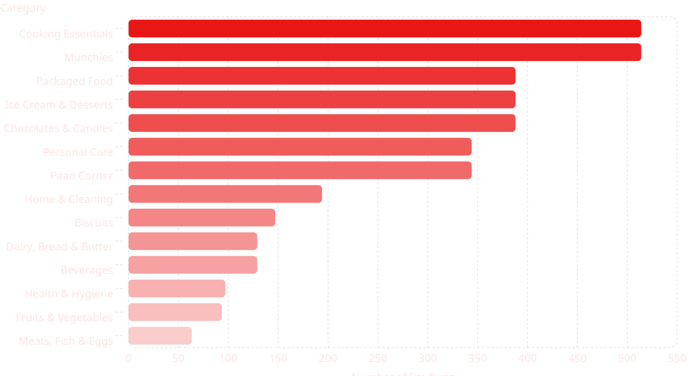
CHAPTER 3
Product Category Breakdown
Cooking Essentials and Munchies lead the catalog with 514 products each, reflecting Zepto's strategic focus on everyday kitchen staples and snack foods. Perishable categories like Meats, Fish & Eggs have the fewest listings at just 63 SKUs.

Slide 5
CHAPTER 4
Key Business Questions — Part 1
Four critical questions were explored to surface actionable commercial insights from the data.
1
2
Best Discount Products
Premium Out-of-Stock Items
The top 10 products ranked by highest discount percentage represent Zepto's best deals — key for attracting deal-seeking customers and driving app traffic.
Products with MRP above ₹300 currently unavailable were flagged. These high-value gaps translate directly to lost revenue and should be restocking priorities.
3
4
Top Revenue Categories
Premium Low-Discount Items
Estimated revenue per category (quantity × selling price) reveals the biggest money-makers and where to concentrate business efforts.
Products above ₹500 with less than 10% discount signal either strong brand positioning or an opportunity for competitive pricing.

Slide 6
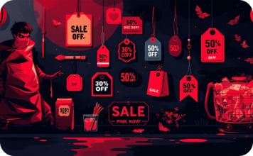

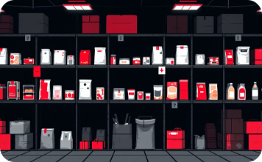

CHAPTER 4 — CONTINUED
Key Business Questions — Part 2
Four more analyses uncovered insights into discounting strategy, value positioning, and inventory logistics.
Highest Avg. Discount Categories
Best Value per Gram
Weight Distribution
Inventory Weight by Category
Price-per-gram analysis on products over 100g reveals the most economical options for staples like rice, flour, and beverages.
Products grouped into Low (<1 kg), Medium (1–5 kg), and Bulk (>5 kg) buckets clarify the product mix between everyday items and bulk purchases.
Total inventory weight per category (weight × quantity) identifies categories requiring the most warehouse space and logistics planning.
The top 5 categories by average discount are likely used to drive volume and customer acquisition — essential for promotion planning.

Slide 7

CHAPTER 5
Stock Health & Discount Analysis
Inventory Snapshot
While 88% of products remain available, 453 SKUs are currently out of stock — including high-margin premium items above ₹300.
In Stock·87.86%
·87.86%
·
Out of Stock·12.14%
With an average discount of just 7.62%, there is room to deploy strategic discounting on high-MRP items to accelerate sell-through and improve conversion rates.
·12.14%
·
₹2,600
₹10
Highest MRP
Lowest MRP

Slide 8


SUMMARY
Key Takeaways & Opportunities
1
Wide & deep catalog
3,732 SKUs across 14 categories is impressive for a quick-commerce platform, with clear focus on daily-use and snack items.
2
Restock premium gaps
453 out-of-stock products — many high-value — represent missed revenue. Prioritize restocking items above ₹300.
3
Sharpen discount strategy
Average discounts hover at 7.6%. Pushing targeted deals on premium SKUs could meaningfully boost conversion and basket size.
4
Surface value-per-gram
Price-per-gram insights could become a customer-facing feature in the app, helping shoppers find the best deals on staples.

